Slide 1
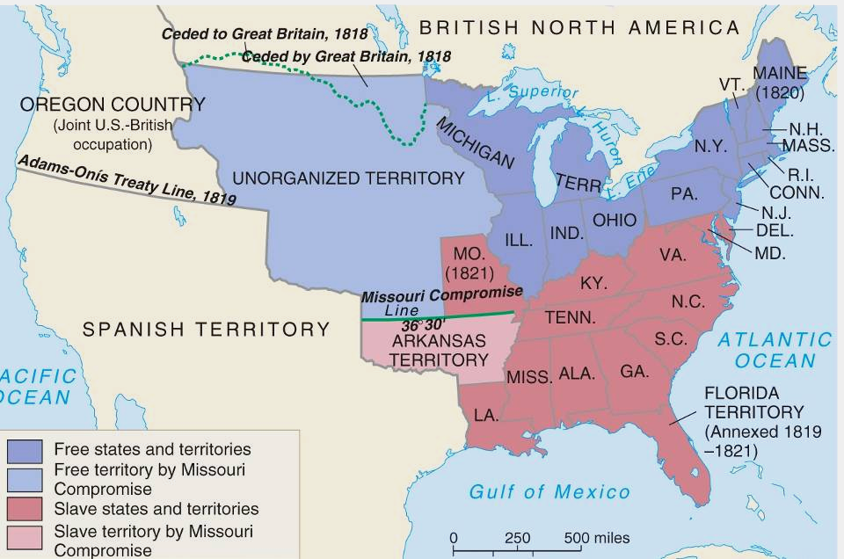
In 1820, Henry Clay negotiated the
Missouri Compromise (Compromise of 1820)
Maine broke from Massachusetts and became a free state
Missouri became a slave state
Slavery was outlawed in
all western territories above the latitude of 36°30'

Slide 2
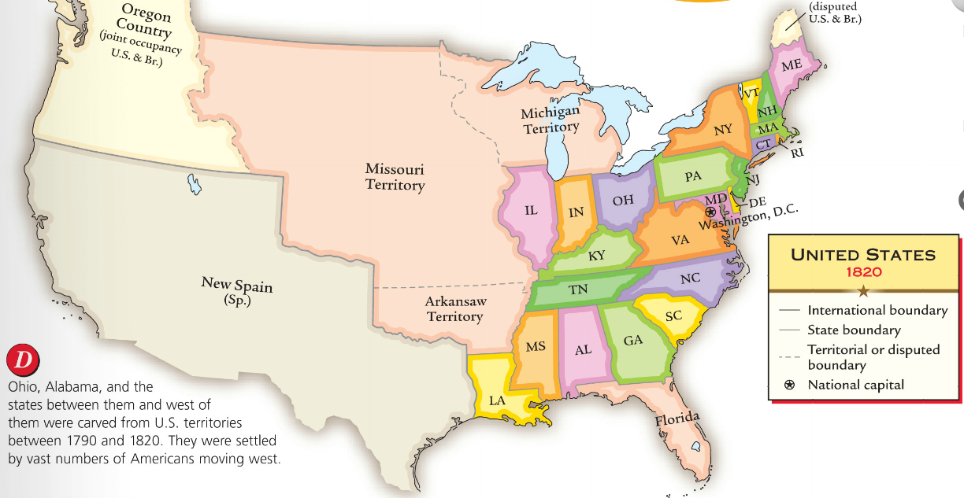
In the early Antebellum era (1800-1840),
the U.S. economy grew rapidly because of an Industrial Revolution
The South, North, and West each developed specialized regional economies that became connected into a national market economy

Slide 3
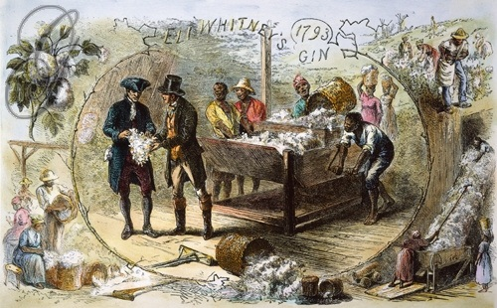
In 1793, Eli Whitney invented the cotton gin making cotton easy to refine and very profitable

Slide 4
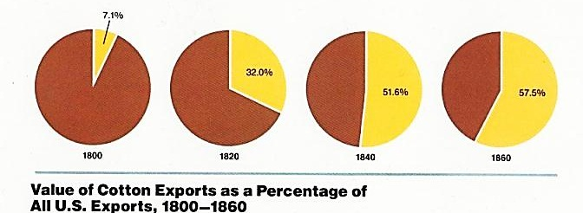
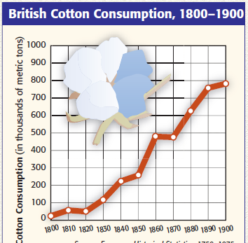
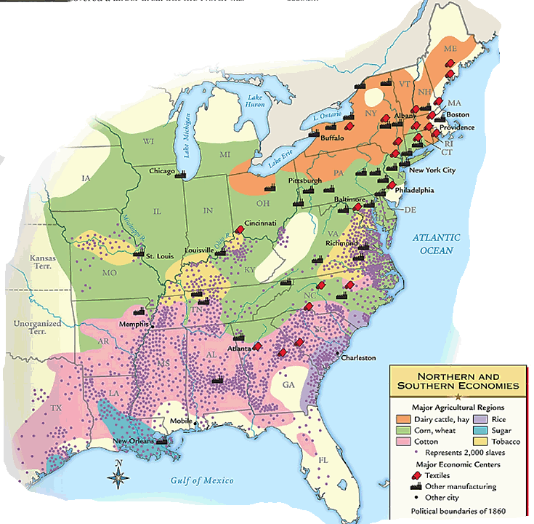
Cotton became the dominant cash crop of the Deep South (known as “King Cotton”)
The South provided 75% of world’s cotton and was the main U.S. export by 1840
Cotton stimulated Northern textile and shipping industries

Slide 5
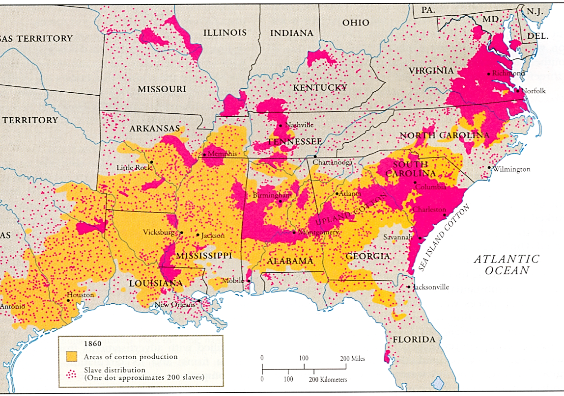
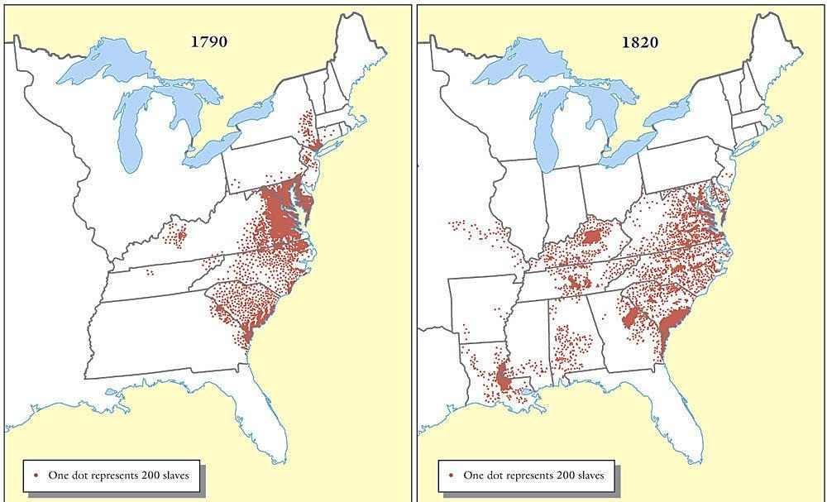
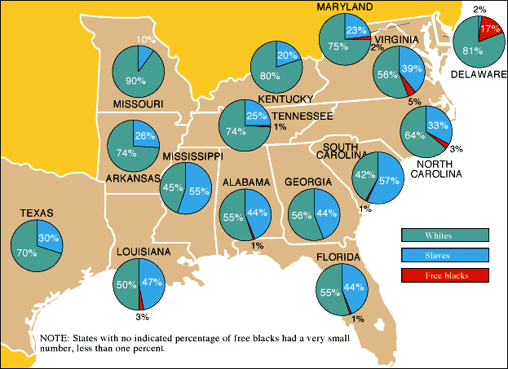
“King Cotton” had important effects on America
Cotton led to an increase in western expansion
Cotton led to an increase in slavery in the Deep South
The Black Belt

Slide 6
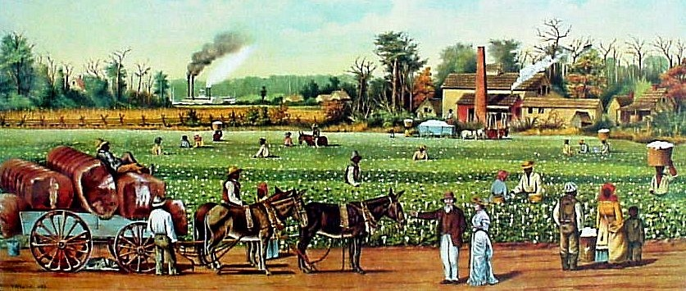
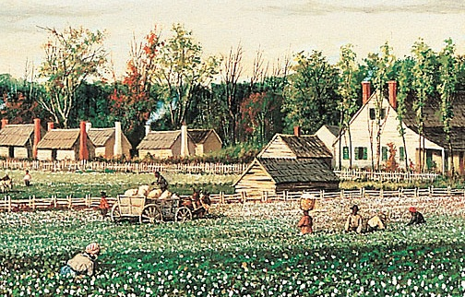
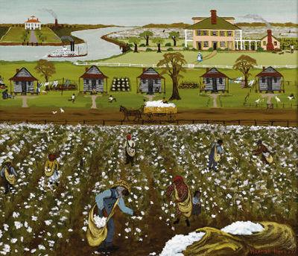

Slide 7
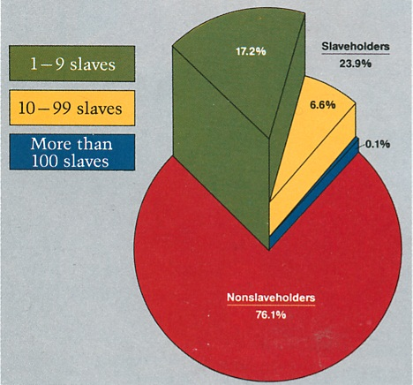
Only 25% of Southern whites owned any slaves; those who did own slaves owned very few
However, most slaves lived on large plantations

Slide 8
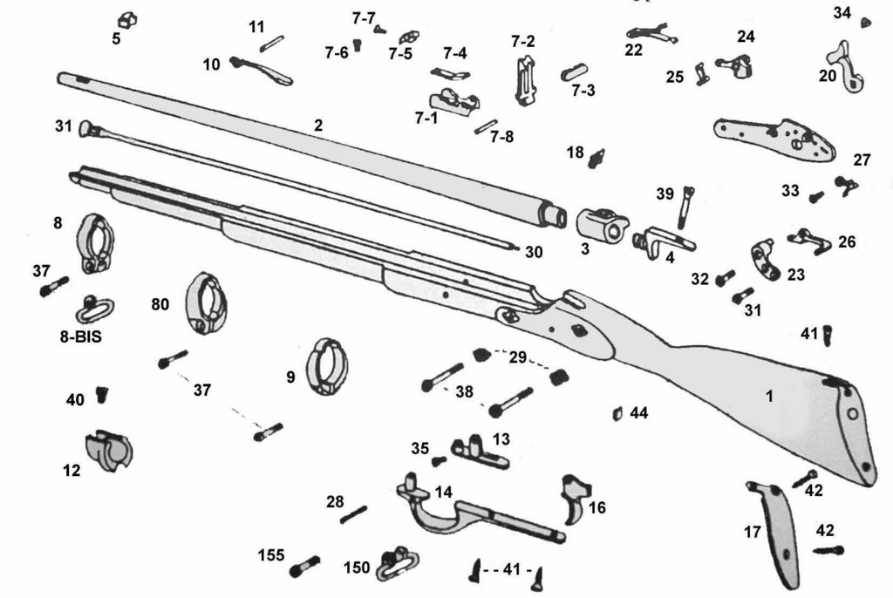
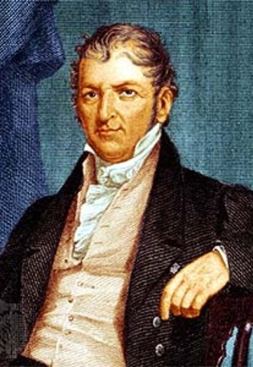
Eli Whitney’s development of interchangeable
parts and new textile technologies led to
an Industrial Revolution in the North

Slide 9
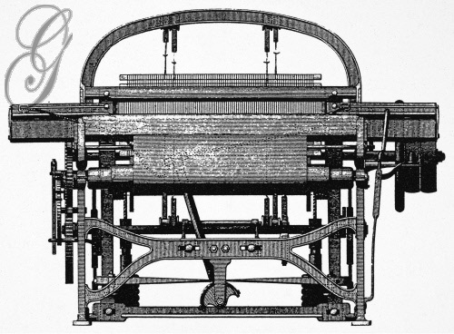
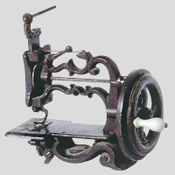
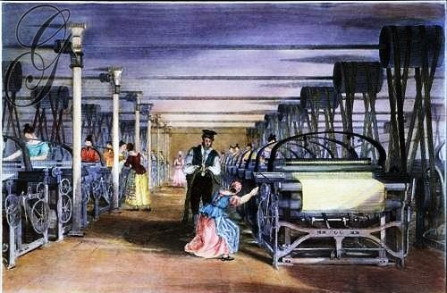
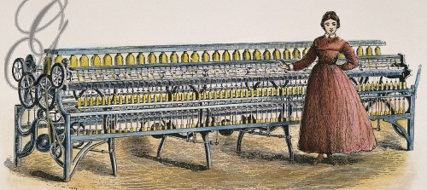
Sewing Machine
Power Loom
Spinning Mule

Slide 10
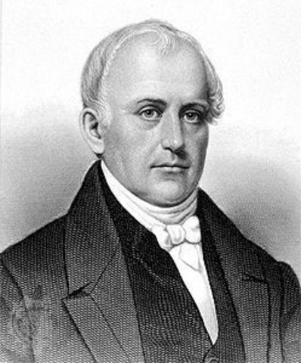
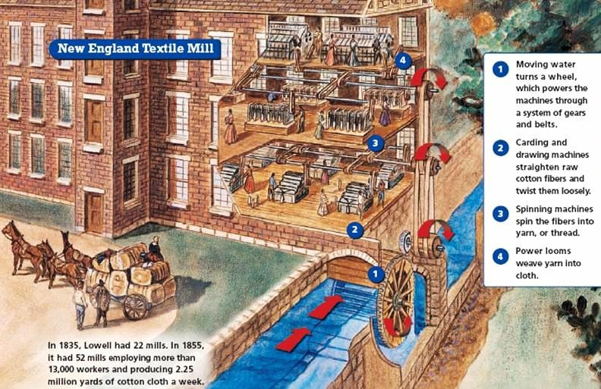
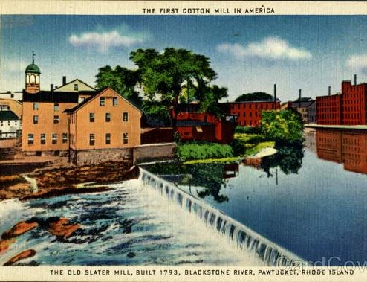
In the 1790s, Samuel Slater used British industrial designs to build
the first American textile factories
In the early 1800s textile mills spread across New England

Slide 11
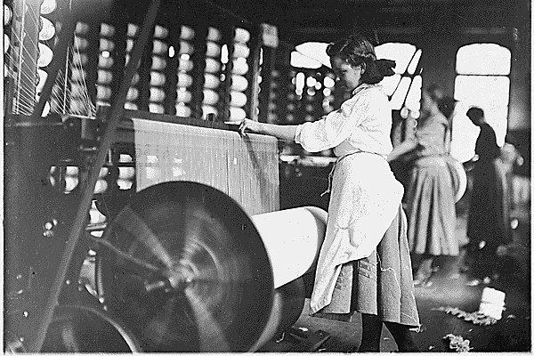
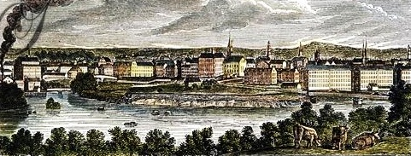
The most famous textile mill in America was the Lowell Mill in Boston
The Lowell Mill used mechanized machines to mass-produce textiles

Slide 12
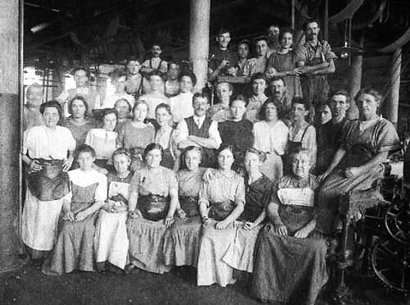
Lowell employed young women (“Lowell girls”)
from the country who lived in boarding houses

Slide 13
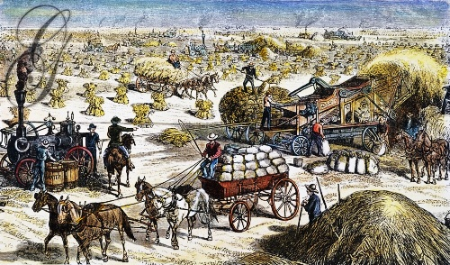
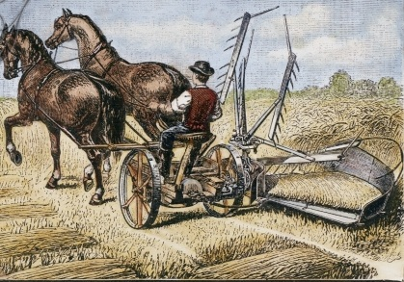
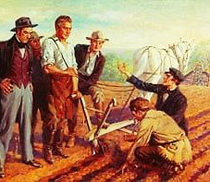
Cyrus McCormick’s mechanical reaper
New technologies made large-scale farming possible
John Deere’s steel plow

Slide 14
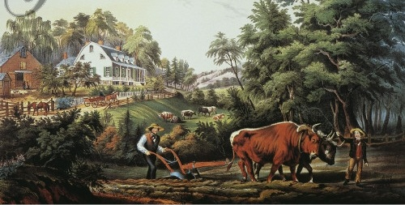
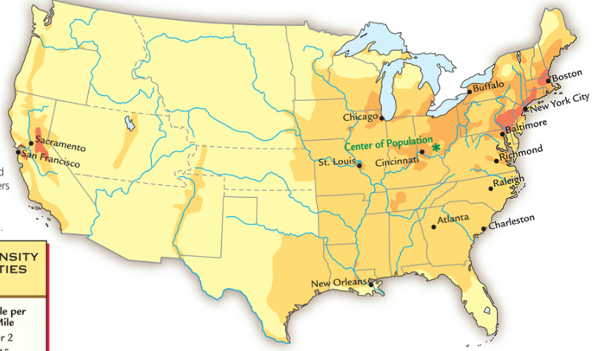
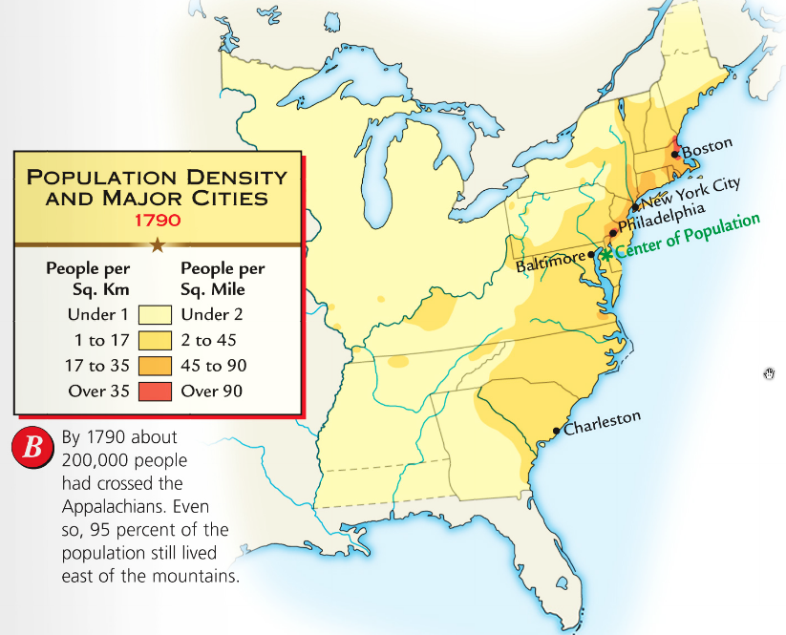
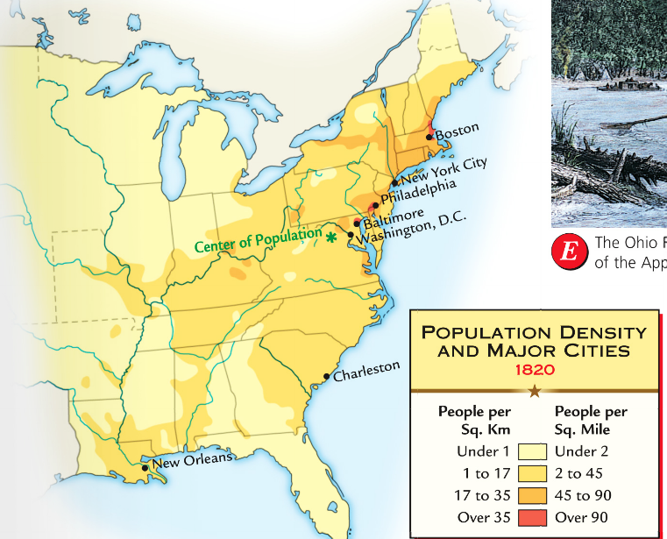
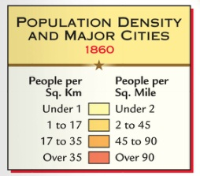
Population
growth and land opportunities
led to rapid growth of the West

Slide 15
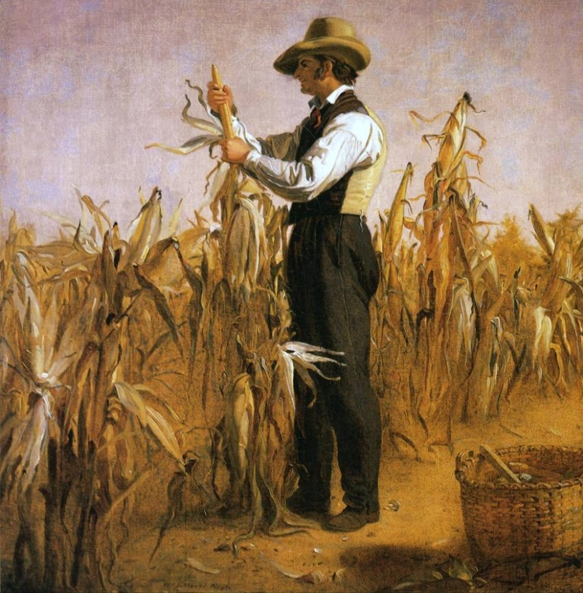
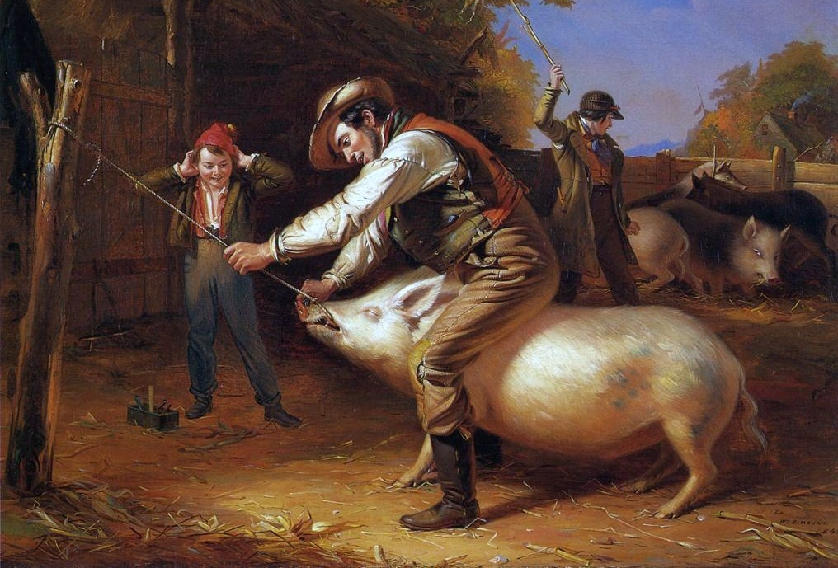
The West became
“America’s bread basket”
where commercial farms produced wheat, corn, livestock

Slide 16
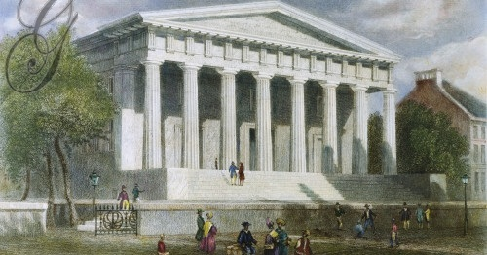
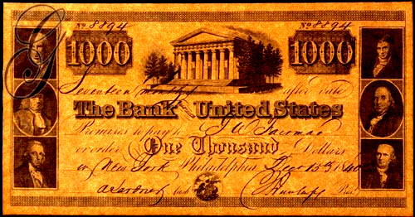
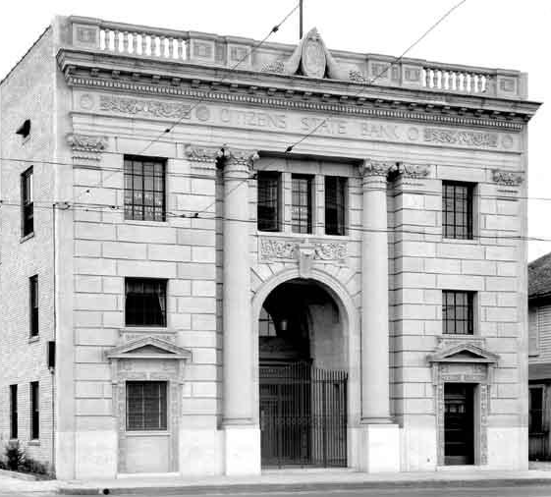
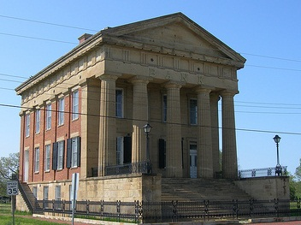
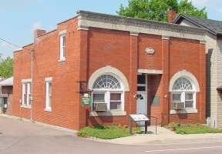
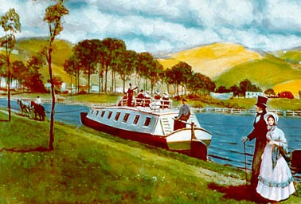
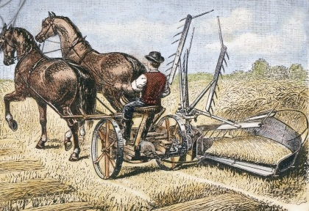
The Second Bank provided federal money for investment and regulation over the U.S. banking system
The BUS held ~$10 million in federal money and loaned it to state banks which forced small banks to be smart when issuing loans
State banks loaned money to individual citizens, businesses, or local governments
to finance roads, canals, factories, & farms

Slide 17
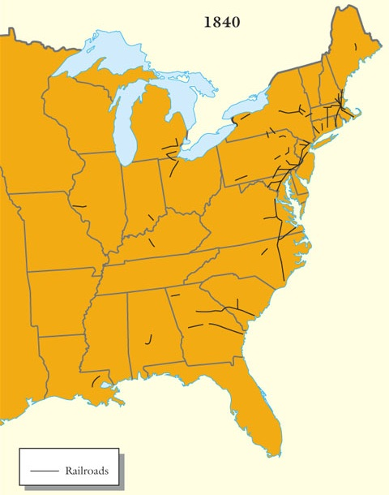
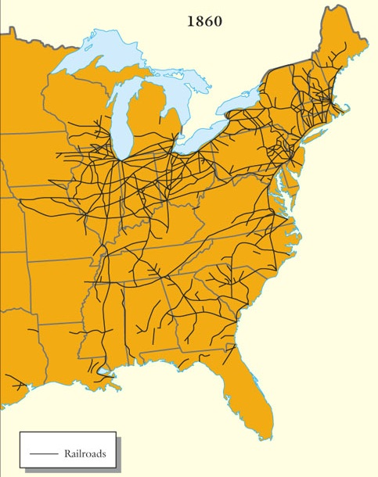
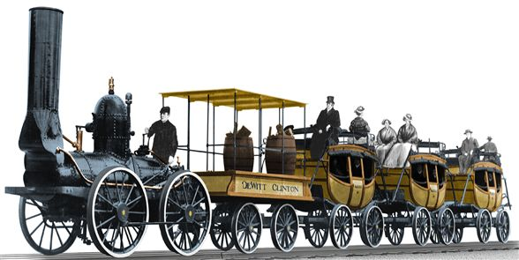
In the 1830s, railroad construction first began
The growth of trains was slow because they were expensive and competed with canals, but…
They were faster than
roads and canals, could travel in any season, and could go in any direction
By 1860, railroads were the dominant means of transportation in America
Notes:
In spite of such objections, it quickly became clear after 1830 that railroads were destined to become the nation's chief means of moving freight. During the 1830s, construction companies laid down 3,328 miles of track, roughly equal to all the miles of canals in the country. With an average speed of 10 miles an hour, railroads were faster than stagecoaches, canal boats, and steamboats, and, unlike water-going vessels, could travel in any season.

Slide 18
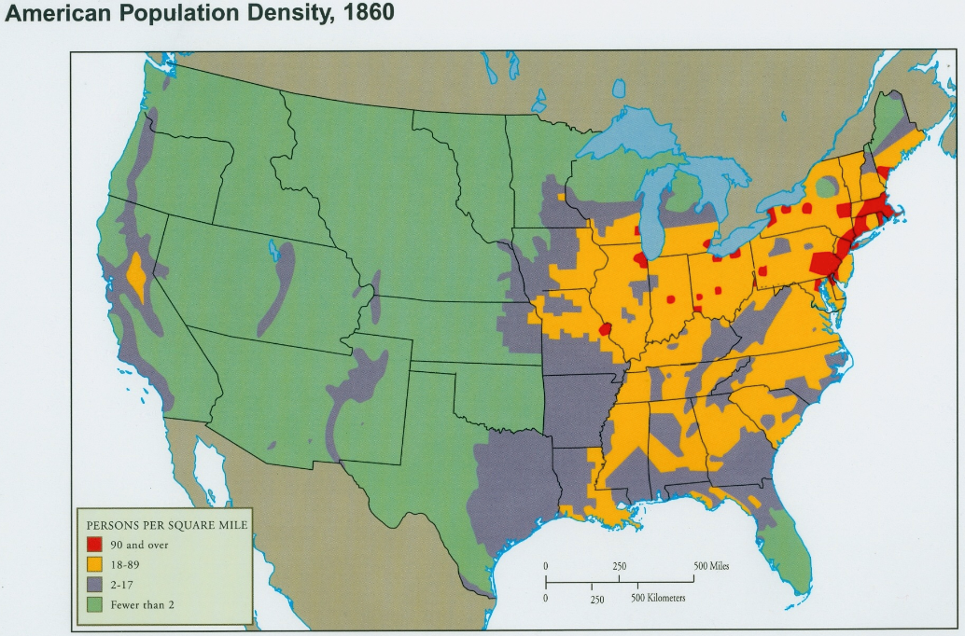
In 230 years, Americans had come to dominate the continent
Americans believed such rapid expansion a result of divine favor….

Slide 19
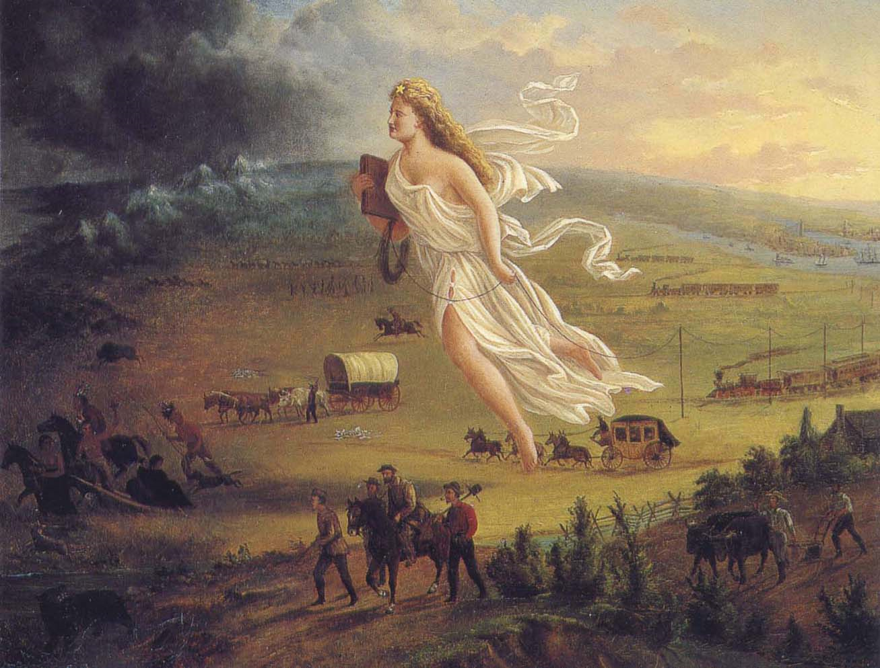
Manifest Destiny, a phrase coined to describe the belief that America was to expand and settle the entire continent of North America
America’s “Manifest Destiny to overspread the continent allotted by Providence for the free development of our yearly multiplying millions.” – John L. O’Sullivan

Slide 20
Review Activity…
*Locate the Industrial Rev/Westward Expansion Review in Google Classroom
* Complete “Part 1: Industrial Revolution Review”
**We will use this “handout” multiple times over the next few weeks to review notes/lectures**

